Slide 1
Introduction to Scientific Computing
Major: All Engineering Majors
Authors: Autar Kaw, Luke Snyder
http://numericalmethods.eng.usf.edu
Transforming Numerical Methods Education for STEM Undergraduates
http://numericalmethods.eng.usf.edu

Slide 2

Introduction
http://numericalmethods.eng.usf.edu

Slide 3
My advice
If you don’t let a teacher know at what level you are by asking a question, or revealing your ignorance you will not learn or grow.
You can’t pretend for long, for you will eventually be found out. Admission of ignorance is often the first step in our education.
  Steven Covey—Seven Habits of Highly Effective People
http://numericalmethods.eng.usf.edu

Slide 4
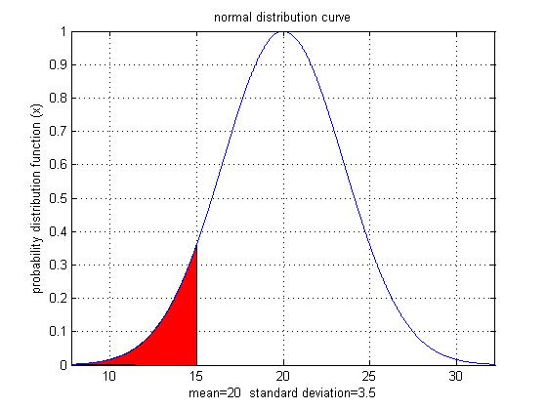
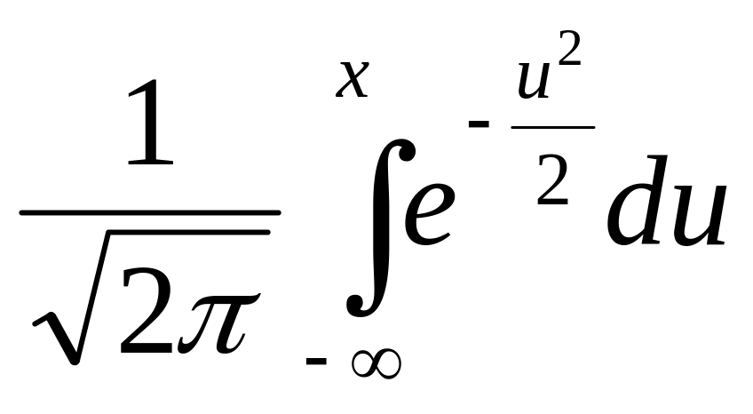
Why use Numerical Methods?
To solve problems that cannot be solved exactly

Slide 5
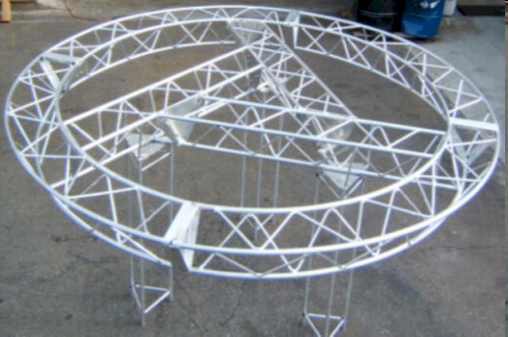
Why use Numerical Methods?
To solve problems that are intractable!

Slide 6
Steps in Solving an
Engineering Problem http://numericalmethods.eng.usf.edu
http://numericalmethods.eng.usf.edu

Slide 7
How do we solve an engineering problem?
Problem Description
Mathematical Model
Solution of Mathematical Model
Using the Solution
http://numericalmethods.eng.usf.edu

Slide 8
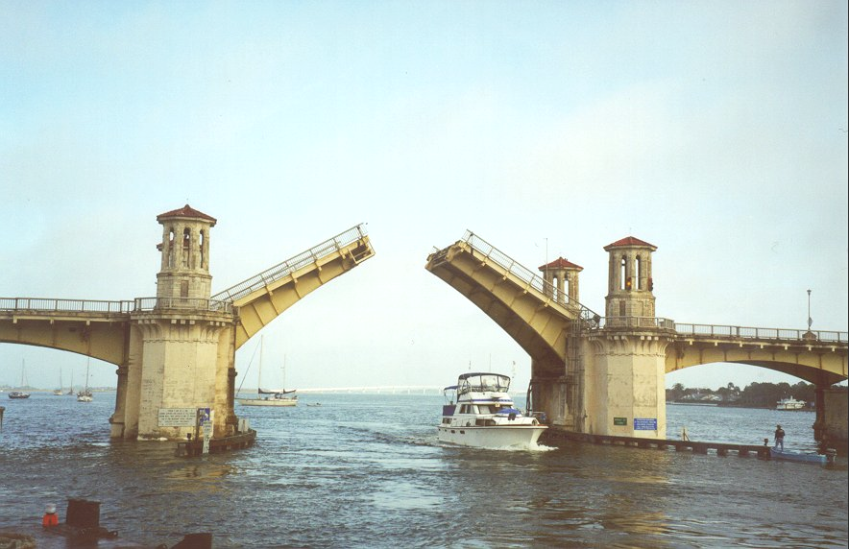
Example of Solving an Engineering Problem
http://numericalmethods.eng.usf.edu
Notes:
Oldest city’s oldest bascule bridge – the Bridge of Lions in St. Augustine, Florida

Slide 9
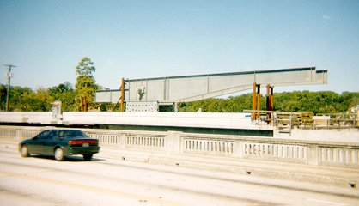
Bascule Bridge THG
http://numericalmethods.eng.usf.edu

Slide 10
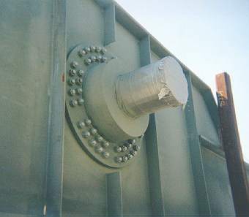
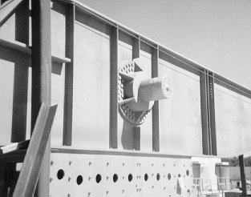
Bascule Bridge THG
Hub
Trunnion
Girder
http://numericalmethods.eng.usf.edu
Notes:
THG picture

Slide 11
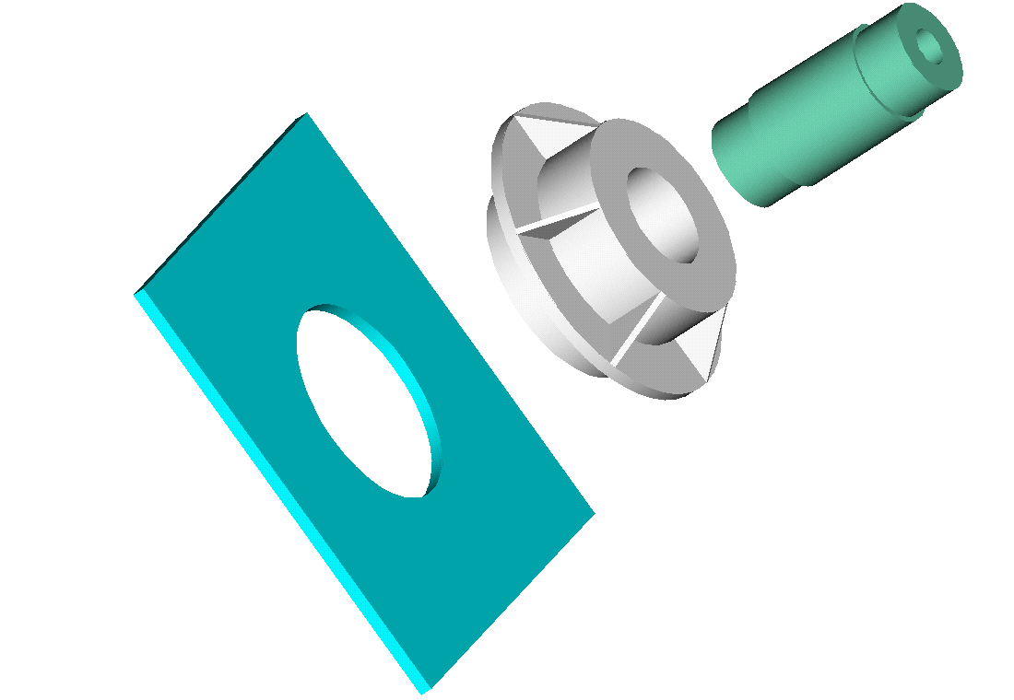
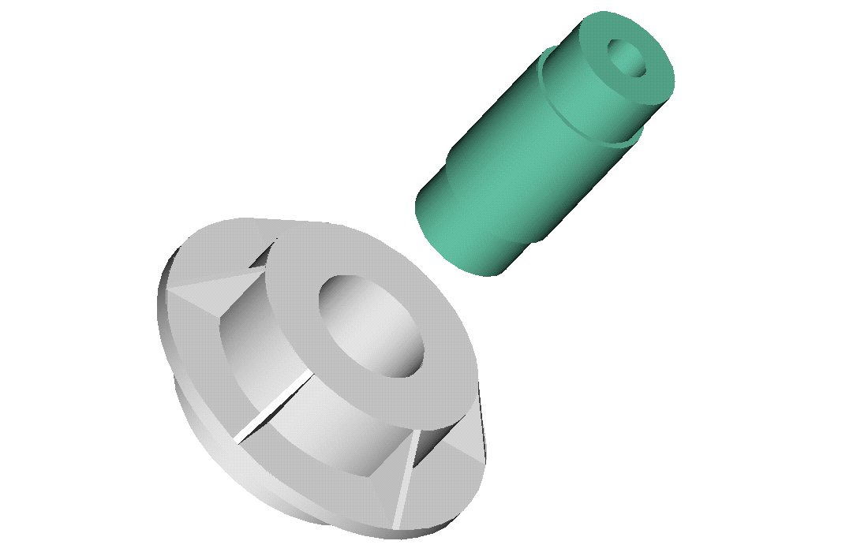
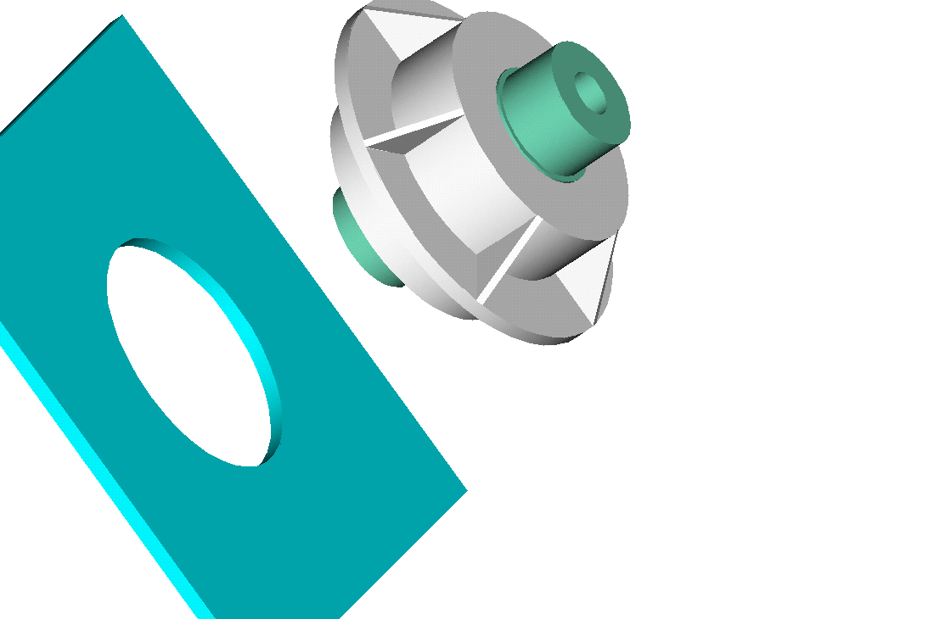
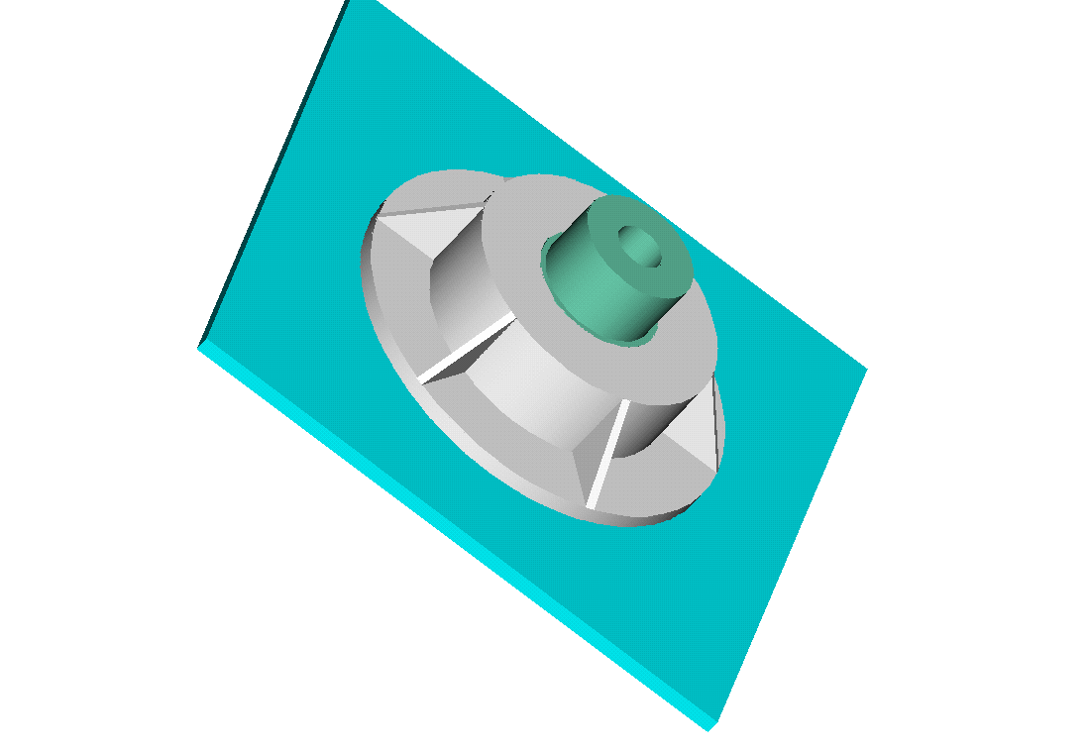
Trunnion-Hub-Girder Assembly Procedure
  Step1. Trunnion immersed in dry-ice/alcohol
  Step2. Trunnion warm-up in hub
  Step3. Trunnion-Hub immersed in
  dry-ice/alcohol
  Step4. Trunnion-Hub warm-up into girder
http://numericalmethods.eng.usf.edu

Slide 12
Problem
After Cooling, the Trunnion Got Stuck in Hub
http://numericalmethods.eng.usf.edu

Slide 13
Why did it get stuck?
Magnitude of contraction needed in the trunnion was 0.015” or more. Did it contract enough?
http://numericalmethods.eng.usf.edu

Slide 14
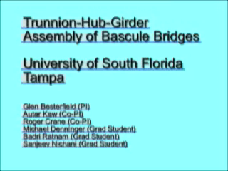
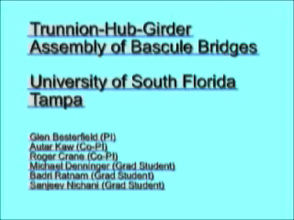
Video of Assembly Process
Unplugged Version
VH1 Version
http://numericalmethods.eng.usf.edu

Slide 15
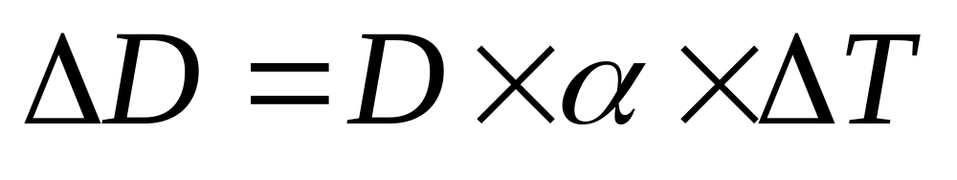
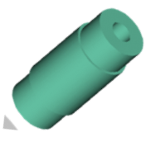
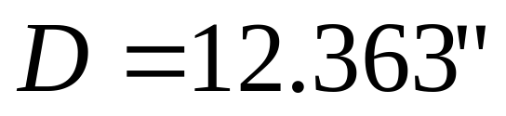
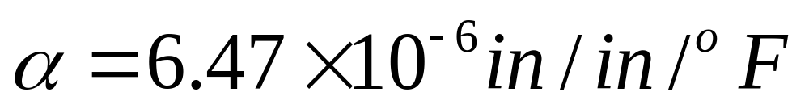
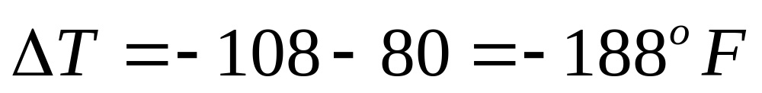
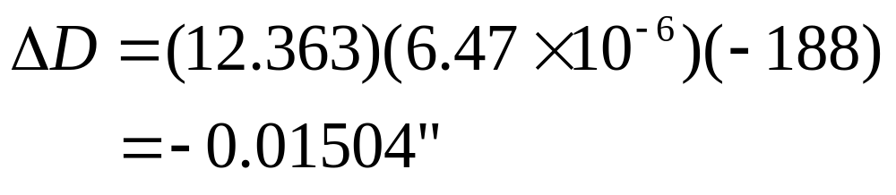
Consultant calculations
http://numericalmethods.eng.usf.edu

Slide 16
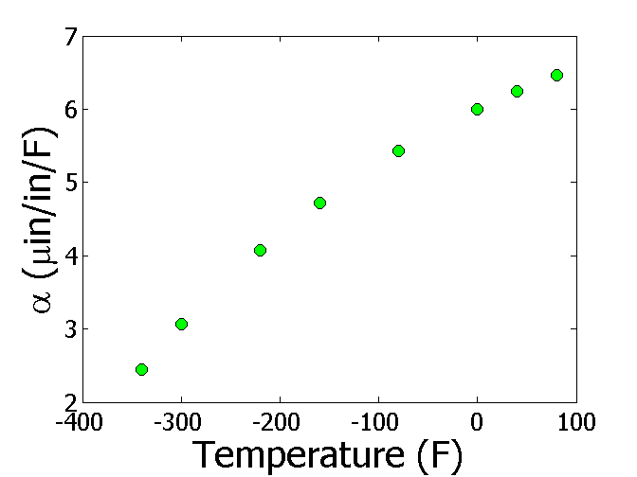

Is the formula used correct?
T(ºF) | α (μin/in/ºF)
-340 | 2.45
-300 | 3.07
-220 | 4.08
-160 | 4.72
-80 | 5.43
0 | 6.00
40 | 6.24
80 | 6.47
http://numericalmethods.eng.usf.edu

Slide 17
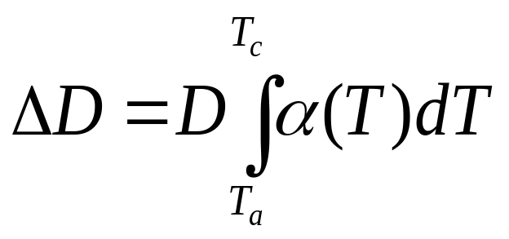
The Correct Model Would Account for Varying Thermal Expansion Coefficient
http://numericalmethods.eng.usf.edu

Slide 18
Can You Roughly Estimate the Contraction?
T_{a}=80ºF; T_{c}=-108ºF; D=12.363”
http://numericalmethods.eng.usf.edu

Slide 19
Can You Find a Better Estimate for the Contraction?
T_{a} = 80ºF
T_{c} = -108ºF
D = 12.363"
http://numericalmethods.eng.usf.edu

Slide 20
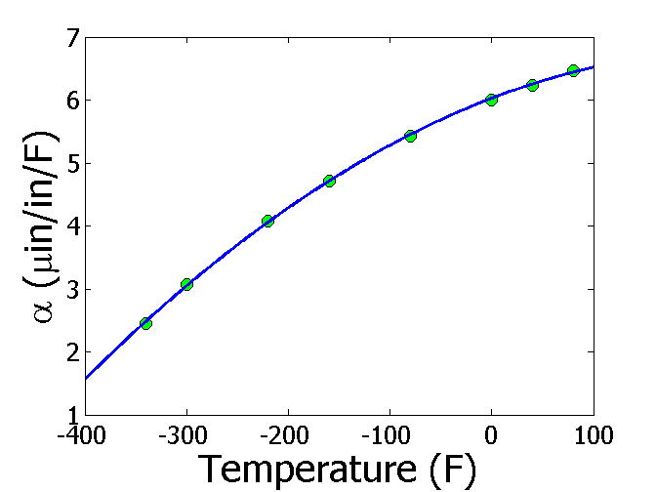
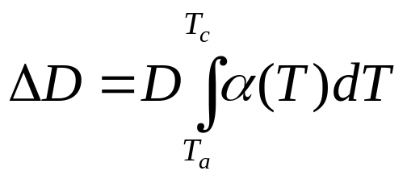
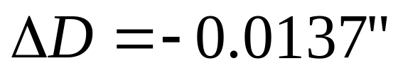
Estimating Contraction Accurately
Change in diameter (ΔD) by cooling it in dry ice/alcohol is given by
T_{a} = 80ºF
T_{c} = -108ºF
D = 12.363"
http://numericalmethods.eng.usf.edu

Slide 21
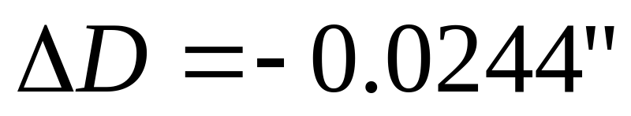
So what is the solution to the problem?
One solution is to immerse the trunnion in liquid nitrogen which has a boiling point of -321ºF as opposed to the dry-ice/alcohol temperature of -108ºF.
http://numericalmethods.eng.usf.edu

Slide 22
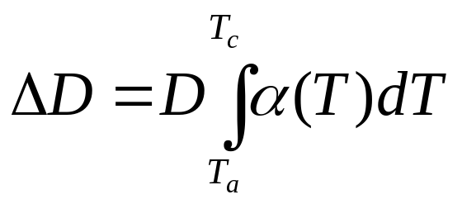
Revisiting steps to solve a problem
1) Problem Statement: Trunnion got stuck in the hub.
2) Modeling: Developed a new model
3) Solution: 1) Used trapezoidal rule OR b) Used regression and integration.
4) Implementation: Cool the trunnion in liquid nitrogen.
http://numericalmethods.eng.usf.edu

Slide 23
THE END
http://numericalmethods.eng.usf.edu
http://numericalmethods.eng.usf.edu

Slide 24
Introduction to Numerical Methods
Mathematical Procedures
http://numericalmethods.eng.usf.edu
http://numericalmethods.eng.usf.edu

Slide 25
Mathematical Procedures
Nonlinear Equations
Differentiation
Simultaneous Linear Equations
Curve Fitting
  Interpolation
  Regression
Integration
Ordinary Differential Equations
Other Advanced Mathematical Procedures:
  Partial Differential Equations
  Optimization
  Fast Fourier Transforms
http://numericalmethods.eng.usf.edu

Slide 26

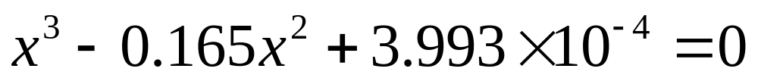
Nonlinear Equations
How much of the floating ball is under water?
Diameter=0.11m
Specific Gravity=0.6
http://numericalmethods.eng.usf.edu

Slide 27
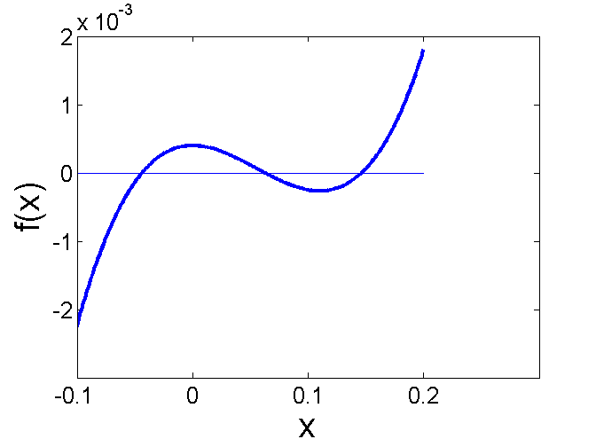
Nonlinear Equations
How much of the floating ball is under the water?
http://numericalmethods.eng.usf.edu

Slide 28
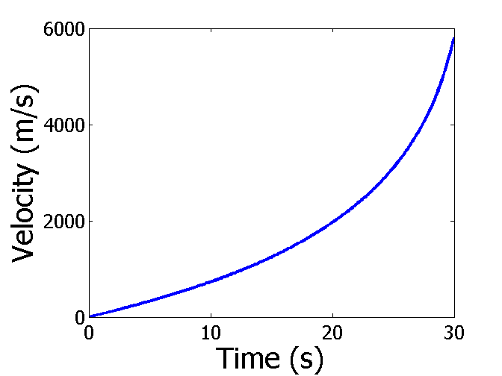

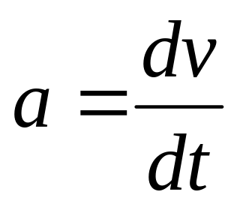
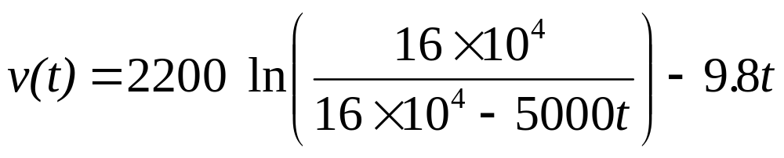
Differentiation
What is the acceleration at t=7 seconds?
http://numericalmethods.eng.usf.edu

Slide 29
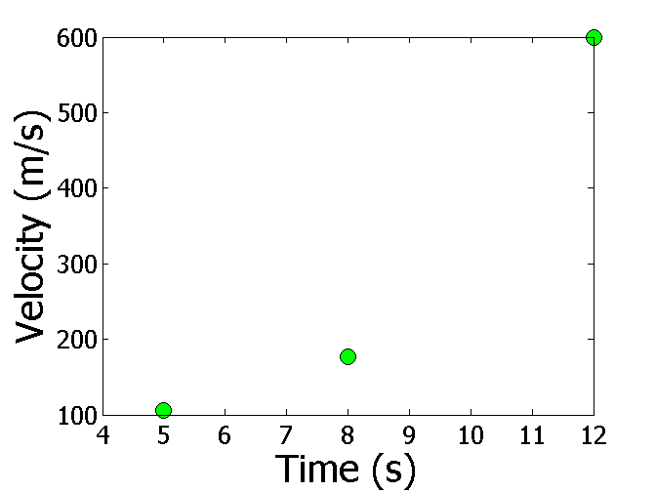
Differentiation
What is the acceleration at t=7 seconds?
Time (s) | 5 | 8 | 12
Vel (m/s) | 106 | 177 | 600
http://numericalmethods.eng.usf.edu

Slide 30
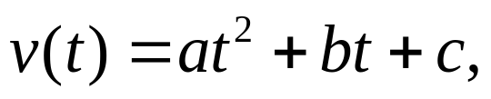

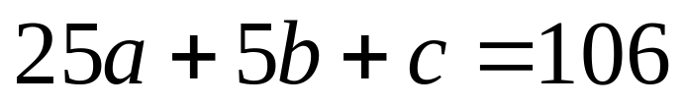
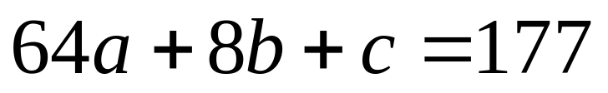
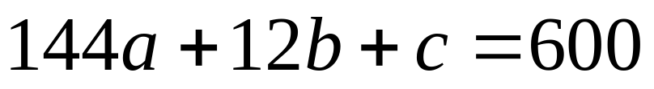
Simultaneous Linear Equations
Find the velocity profile, given
Time (s) | 5 | 8 | 12
Vel (m/s) | 106 | 177 | 600
Three simultaneous linear equations
http://numericalmethods.eng.usf.edu

Slide 31
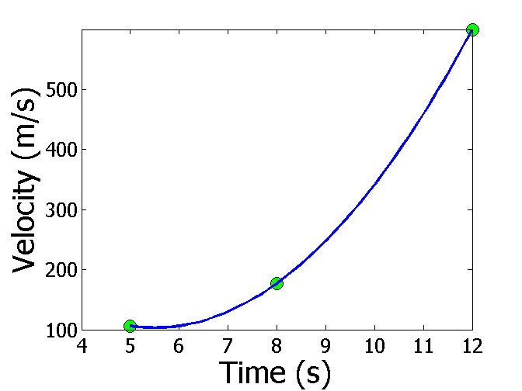
Interpolation
What is the velocity of the rocket at t=7 seconds?
Time (s) | 5 | 8 | 12
Vel (m/s) | 106 | 177 | 600
http://numericalmethods.eng.usf.edu

Slide 32
Regression
Thermal expansion coefficient data for cast steel
http://numericalmethods.eng.usf.edu

Slide 33
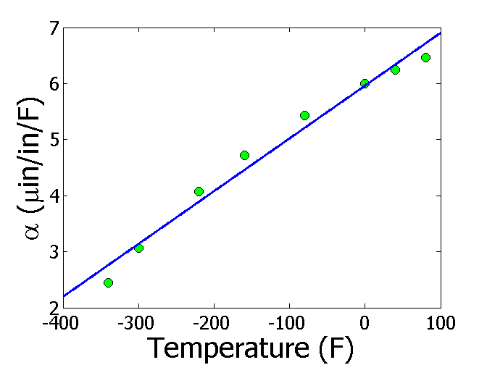
Regression (cont)
http://numericalmethods.eng.usf.edu

Slide 34
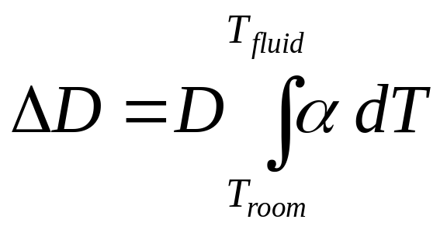
Integration
Finding the diametric contraction in a steel shaft when dipped in liquid nitrogen.
http://numericalmethods.eng.usf.edu

Slide 35
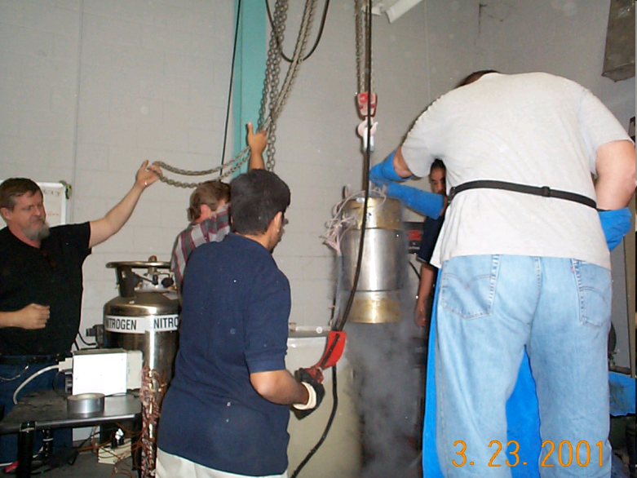
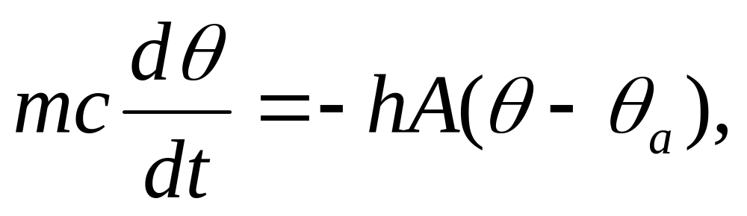
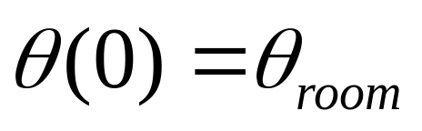
Ordinary Differential Equations
How long does it take a trunnion to cool down?
http://numericalmethods.eng.usf.edu

Slide 36
Additional Resources
For all resources on this topic such as digital audiovisual lectures, primers, textbook chapters, multiple-choice tests, worksheets in MATLAB, MATHEMATICA, MathCad and MAPLE, blogs, related physical problems, please visit
http://numericalmethods.eng.usf.edu/topics/introduction_numerical.html

Slide 37
THE END
http://numericalmethods.eng.usf.edu

